Slide 1
Implement your own chatbot with Python By Wang Yan

Slide 2
Agend
introduce chatbot
introduce python
install Development environment
run our own chatbot
design our own chatbot
code our own chatbot

Slide 3
Intro Chatbot
A chatbot (also known as a talkbot, chatterbot, Bot, IM bot, interactive agent, or Artificial Conversational Entity) is a computer program or an artificial intelligence which conducts a conversation via auditory or textual methods. Such programs are often designed to convincingly simulate how a human would behave as a conversational partner, thereby passing the Turing test. Chatbots are typically used in dialog systems for various practical purposes including customer service or information acquisition. Some chatterbots use sophisticated natural language processing systems, but many simpler systems scan for keywords within the input, then pull a reply with the most matching keywords, or the most similar wording pattern, from a database.

Slide 4
Different types of chatbot
based on predefined template
based on indexing
based on machine translation
based on deep learning

Slide 5
Install Development Enviornment
Here is an example on Linux(CentOS)
Please google install python3 on mac/windows/linux for your usage

Slide 6

Install IDE Tool- Pycharm
Install community edition for free

Slide 7
Import Project and Set up Interpreter in Pycharm
This example is under windows.
Here we use virtualenv as interpreter
1 import project
2 set interpreter by clicking red color marked icon

Slide 8
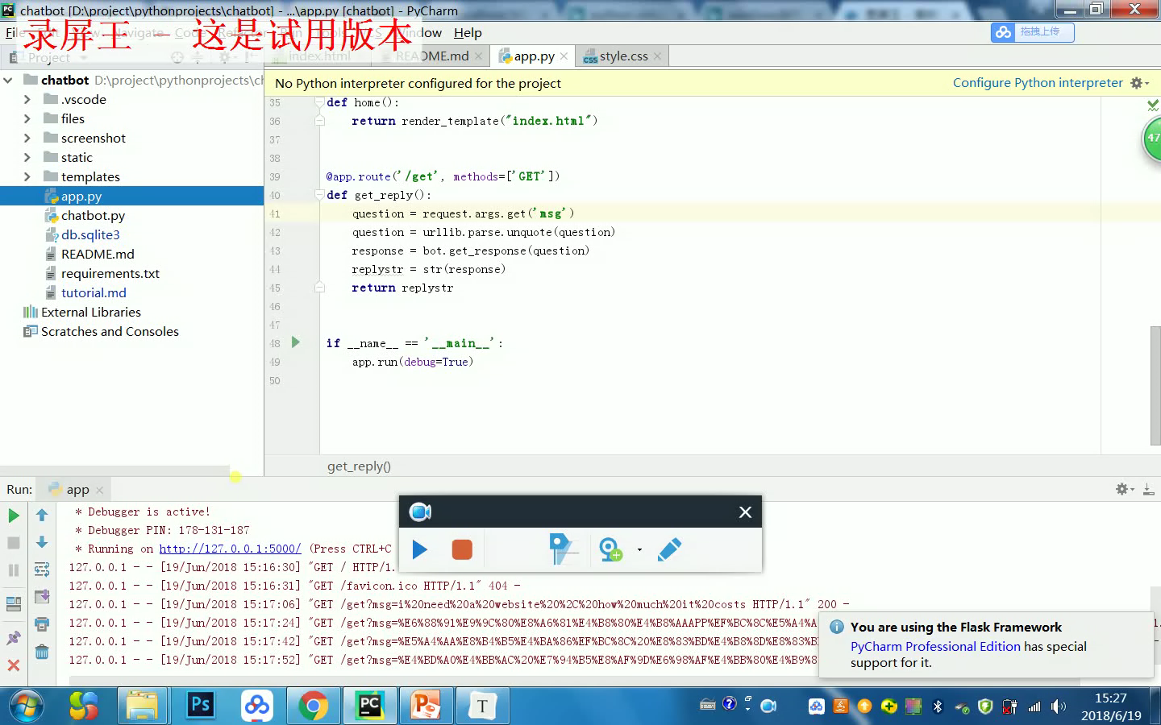
Demo

Slide 9
Design Chatbot
input model - user inputs questions
chatbot model - chatbot responses questions
output model – displays responses to user

Slide 10
Input Module
user inputs quetsions in html form and sends questions via GET method (webservice) to chatbot

Slide 11
Chatbot Module
initialize chatbot, let bot to use Q&A conversion template , based on the template to response questions

Slide 12
Chatbot Module

Slide 13
Output Module

Slide 14
Reference Link
Chatbot Demo Download
https://github.com/stewchicken/chatbot
Install Python https://www.liaoxuefeng.com/wiki/0014316089557264a6b348958f449949df42a6d3a2e542c000/0014316090478912dab2a3a9e8f4ed49d28854b292f85bb000
Virtualenv
https://www.the5fire.com/virtualenv-python-env.html
Anaconda
https://blog.csdn.net/jbhand/article/details/77883457
Pycharm
https://blog.csdn.net/gaokao2011/article/details/77163820

Slide 15
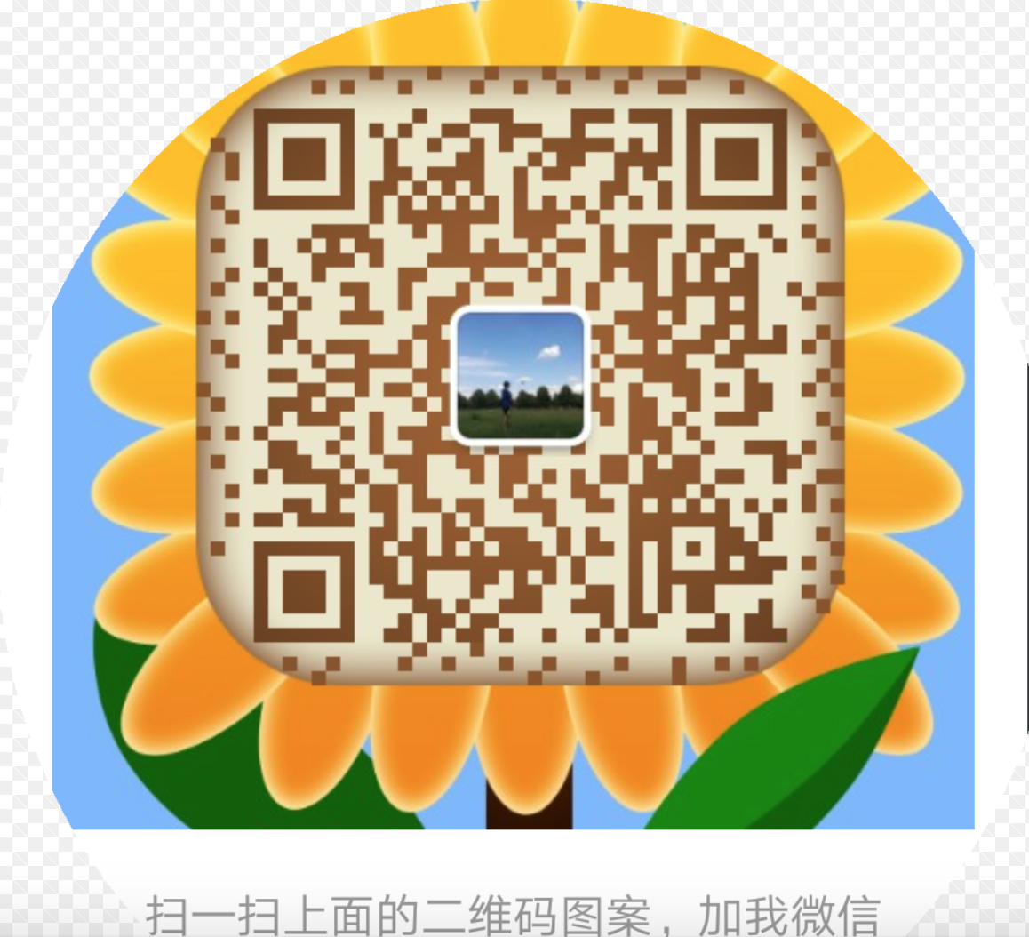
Thank You

